Slide 1

SOFTWARE TESTING

Slide 2
Lecture & Laboratory Times
Lectures
Wednesday 3pm – 4pm Room 939
Laboratories Sessions
Monday 11am - 1pm – CR4 (4th Years)
Monday 4pm – 6pmm CR4 (3rd Years - Group A)
Tuesday 9am – 11am CR 5 (3rd Years - Group C)
Thursday 2pm – 4pm CR 5 (3rd Years - Group B)

Slide 3
Course Assessment Breakdown
20% - Lab Exam 1 (Selenium)
10% - Lab Exam 1 (WebDriver / Junit)
20% - Assignment
50% - Written Exam

Slide 4
1.FUNDAMENTALS OF TESTING

Slide 5

Question
Why do pilots bother doing pre-flight checks when the chances are that the plane is working fine?

Slide 6
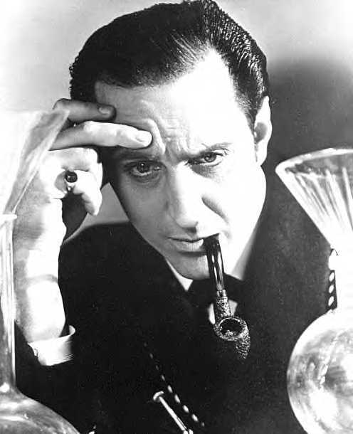
Software Testing
Software testing is an investigate process to measure the quality of software.
Test techniques include, but are not limited to, the process of executing a program or application with the intent of finding software bugs.

Slide 7

Software Testing
How is a software system built?
Customer contacts an I.T. Company and requests that a software system be created
The customer works with an analyst to define a design of the software system
The design is given to developers to build the software system
The developed system is given to software testers to check if it is OK
The system is handed over to the customers

Slide 8
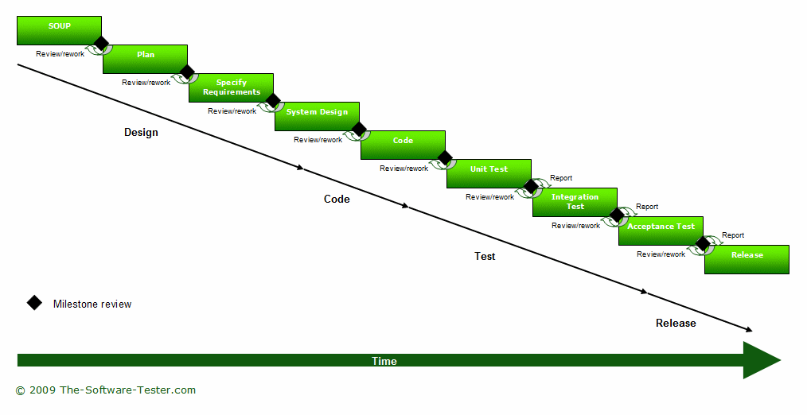
Software Testing

Slide 9
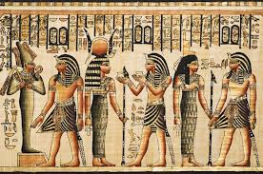
A bit of history...

Slide 10
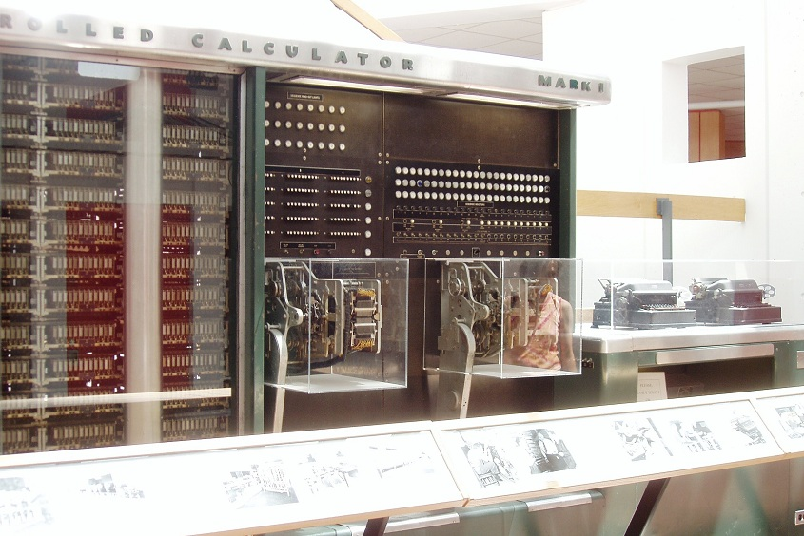
Harvard Mark I
1944AD
The IBM Automatic Sequence Controlled Calculator (ASCC), called the Mark I by Harvard University was an electro-mechanical computer.
It was devised by Howard H. Aiken, built at IBM and shipped to Harvard in February 1944.
It began computations for the U.S. Navy Bureau of Ships in May and was officially presented to the university on August 7, 1944.
It was very reliable, much more so than early electronic computers.

Slide 11

Howard H. Aiken
Howard Hathaway Aiken
Born March 8, 1900
Died March 14, 1973
Born in Hoboken, New Jersey
He envisioned an electro-mechanical computing device that could do much of the tedious work for him.
With help from Grace Hopper and funding from IBM, the machine was completed in 1944.

Slide 12

Grace Hopper
Rear Admiral Grace Murray Hopper
Born December 9, 1906
Died January 1, 1992
Born in New York City, New York
Computer pioneer who developed the first compiler for a computer programming language

Slide 13
The First Bug
1945AD
Grace Hopper served at the Bureau of Ships Computation Project at Harvard University working on the computer programming staff.
A moth was found trapped between points at Relay #70, Panel F, of the IBM Harvard Mark II Aiken Relay Calculator while it was being tested at Harvard University, 9 September 1945.
The operators affixed the moth to the computer log, with the entry: "First actual case of bug being found".
Grace Hopper said that they "debugged" the machine, thus introducing the term "debugging a computer program".

Slide 14
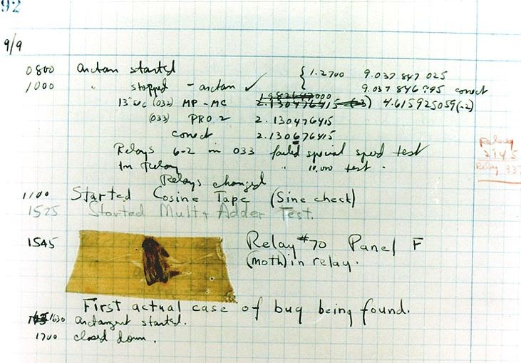

Slide 15
Bugs a.k.a. …

Slide 16

Terminology used in the world of Bugs
Priority | Category | Description
1 | Blocker | A Defect which blocks all development work and/or the carrying out of Acceptance Tests
2 | Critical | The Platform is unusable, e.g. software crash, loss of data or a severe memory leak
3 | Major | A major component/theme of the Platform is unusable; major loss of functionality or major missing functionality
4 | Minor | A minor loss of functionality or other problem where an easy workaround is present
5 | Trivial | A cosmetic problem, e.g. spelling errors or misaligned text

Slide 17
Eras of Testing
Gelperin, D.; Hetzel, B. (1988). "The Growth of Software Testing". CACM 31 (6).
Years | Era | Description
1945-1956 | Debugging orientated | In this era, there was no clear difference between testing and debugging.
1957-1978 | Demonstration orientated | In this era, debugging and testing are distinguished now - in this period it was shown, that software satisfies the requirements.
1979-1982 | Destruction orientated | In this era, the goal was to find errors.
1983-1987 | Evaluation orientated | In this era, the intention here is that during the software lifecycle a product evaluation is provided and measuring quality.
1988- | Prevention orientated | In the current era, tests are used to demonstrate that software satisfies its specification, to detect faults and to prevent faults.

Slide 18

Human and other causes of Software Defects
Rate at which people make mistakes increases

Slide 19
Significant number of defects introduced in work products other than code
20% defects introduced in requirements
25% introduced in design
55% introduced during implementation or repair of the code, metatdata or documentation
One organization claimed 75% of defects originate in requirements and design.
Phase Containment
Ideally defects should be removed in the same phase of the life cycle in which they are introduced.

Slide 20

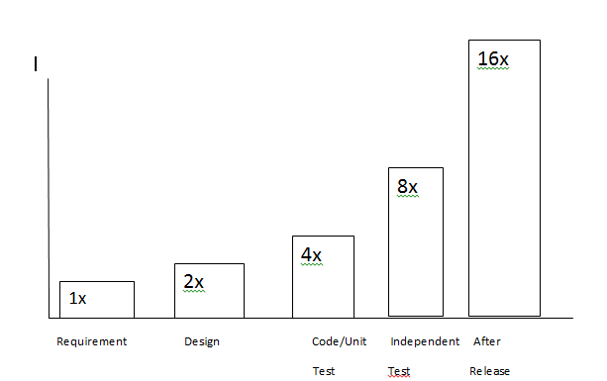
Cost of Finding Defects
cost

Slide 21

Role of Testing and its effect on Quality
Try to reduce the risk of failure to an acceptable level prior to release
Testing does provide a way to measure Systems Quality
Rate of defect Discovery
Number of known defects
Extent of test coverage
Percentage of tests passed

Slide 22

How much testing is enough?
Cover the most important parts of system
Testing shows the presence of defects
No test team, test technique or test strategy will achieve 100% defect detection effectiveness.

Slide 23
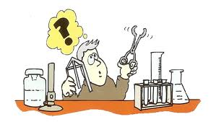
Test data and test cases
Test data Inputs which have been devised to test the system
Test Plan - document that describes the objectives, scope, approach, and focus of a software testing effort- collection of test cases
A test case - document that describes an input, action, or event and an expected response, to determine if a feature of an application is working correctly.
A test case
test case identifier, test case name, objective, test conditions/setup, input data requirements, steps, and expected results.

Slide 24
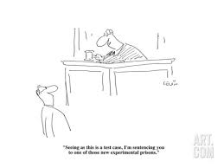
Test Case is a testing work product that automatically performs a singe test on an executable work product. otherwise in simple we can define is a set of procedures in order to find out the defects.
A good test case has certain characteristics which are:
1. Should be accurate and tests what it is intended to test. 2. No unnecessary steps should be included in it. 3. It should be reusable. 4. It should be traceable to requirements. 5. It should be compliant to regulations. 6. It should be independent i.e. You should be able to execute it in any order without any dependency on other test cases. 7. It should be simple and clear, any tester should be able to understand it by reading once. 8. Now keeping in mind these characteristics you can write good and effective test cases.

Slide 25
Seven Most Common Mistakes
The seven most common mistakes
l
Making cases too long
l
Incomplete, incorrect, or incoherent setup
l
Leaving out a step
l
Naming fields that changed or no longer exist
l
Unclear whether tester or system does action
l
Unclear what is a pass or fail result
l
Failure to clean up

Slide 26

TIPS for writing good test cases
Tests only one thing
Always make sure that your test case tests only one thing, if you try to test multiple conditions in one test case it becomes very difficult to track results and errors.
Organize your test cases consistently
You can organize your test cases in many ways however you should always follow the same pattern to organize you test cases.
Write independent test cases
Your test cases should not have dependency on other test cases, i.e you should be able to execute your test case individually with having dependency on other test cases.
Write small test cases
Always mention purpose of each test case clearly in test case.

Slide 27
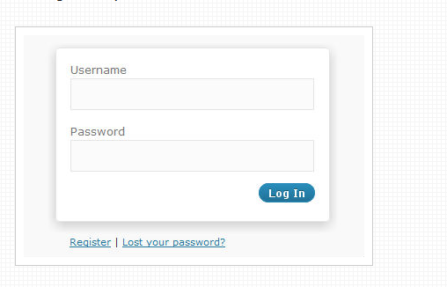
How to write Test Cases
As a software tester, you should always think like a person who is using it, and you need to imagine various scenarios, which will happen in the real time environment.
If you do this creative visualization you are rest assured that the application is more or less an error free.
Just always see the application in a Negative way, as a software tester your attitude must be always negative with the application, if you have this attitude you can easily find out the mistakes.

Slide 28

Terminologies used in Testing

Slide 29
Test Condition( something that could be tested) : An item or event of a component or system that could be verified by one or more test cases
e.g. function, transaction, feature, quality attribute or structural element
Test Basis Documents upon which we base our tests. Test Basis can include requirements, design specifications, risk analysis reports, system design and architecture, and interface specifications.
Incident Any event occurring that requires investigation
Testware Artifacts produced during the test process – eg documentation, scripts, inputs, expected results, set-up and clear-up procedures, files,databases,environment and any additional software or utilities required for testing
Regression Testing Testing of a previously tested program following modification to ensure defects have not been introduced or uncovered in unchanged areas of the software as a result of the changes made

Slide 30
Confirmation Testing( re-testing): Testing that runs test cases that failed the last time they were run.
Test Strategy: A high level description of the test levels to be performed and the testing within those levels for an organization or project/s.

Slide 31
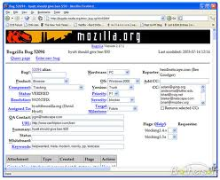
Bug Tracking Systems

Slide 32
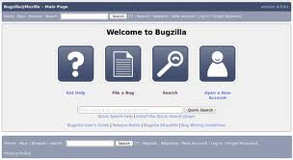
Test case management is the process of tracking test outcomes on a set of test cases for a given set of environments and development iterations.
Mozilla's Bugzilla bug tracking system is one of the most popular open source issue tracking systems available.
Bugzilla “provides an easy to use, easy to maintain and cost effective solution with a rich feature set .
Test cases are, and should be, closely tied to defects. As defects are found, test cases should be written to verify that the defect is fixed in future releases.
To this end Testopia was designed as an add-on extension to Bugzilla. This allows a single user experience and point of product management for both defect tracking and test case management.

Slide 33
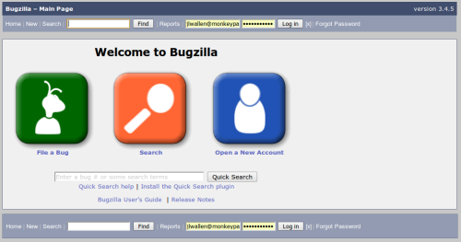
Bugzilla
Bugzilla is a Web-based general-purpose bugtracker and testing tool originally developed and used by the Mozilla project

Slide 34

Testopia was developed to provide a central repository for the
collaborative efforts of distributed testers. I
It serves as both a test case repository and management system.

Slide 35
Freely available to run on open source tools. Released under the Mozilla Public Licence so it’s free
Attractive to developers is its lightweight implementation and speed
Relatively easy to install (for non-Linux/UNIX administrators steps can be confusing)
Most popular of the open source bug tracking tools
Web-based, written in Perl, and uses MySQL as its database back-end
Comprehensive permissions system
Advanced query tool remembers searches
Integrated email capabilities
Excellent security
Reporting and charting

Slide 36

Software Quality Assurance system offering
Requirements management,
Test management
Business processes
Proprietary licence
HP Quality Center is a component of the HP Application Lifecycle Management software solution.
HP Application Lifecycle Management
Release specifications
Requirement specifications
Test planning
Test execution
Defect tracking
Project management
Proprietary licence

Slide 37
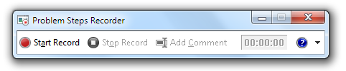
JIRA
Developed by Atlassian,
Commercial software
Bug tracking system,
Project Management System
Developed in Java
Common tools used for capturing Screenshots:
Snipping tool (free download)
Jing (free download)
Paint (comes with Windows 7)
Problem Step Reporting (comes with Windows 7)

Slide 38
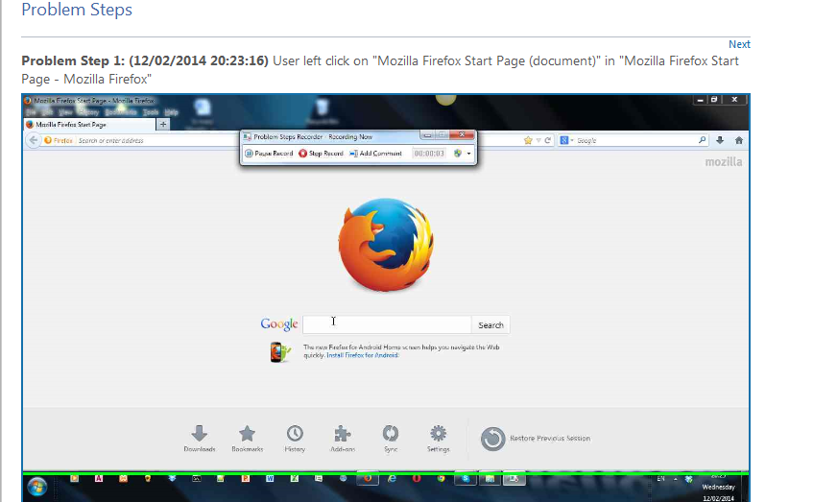

Slide 39

What is Testing?
Major Activities in the Test Process
Test Planning
Establish scope, approach, resources, schedule and specific tasks in the intended test activities
Test Control
Develop and carry out corrective actions to get a test project back on track when plans don’t work out
Test Analysis
Identify what to test and choose the test conditions( something we could test) we need to cover and test cases
Review the test basis
Identify and prioritise test conditions
Design and prioritize test cases
Identify necessary test data to support test conditions and test case
Design test environment
Create traceability between test basis documents and test cases

Slide 40
Test Design
Determine how we will test what we decided to test during analysis
Test Implementation
Develop and Prioritize test procedures, create test data and set up test environments
Verify test environment set up correctly
Verify and update bi-directional traceability to ensure adequate test coverage
Execute the test procedures manually or with the use of an automated test tool
Compare results and log incidents
Log outcome of test execution- pass/fail status of test cases and versions of software used under test, test tools and testware
Analyse the incidents- defects in code (failure), Other incidents may be defects in test data, in test document or simply a mistake in execution of test
Rerun tests – Regression testing
Checking Results
Compare actual results against expected results
Anomalies should be logged as incidents for further investigation

Slide 41
Evaluating Exit Criteria
Exit Criteria are the set of conditions, agreed upon with the stakeholders ofr permitting a process to be officially completed. The purpose is to prevent a process from been considered completed when certain task/s have not been finished.
Exit criteria are used to plan when to stop testing
Assess if more tests are needed or should the exit criteria be changed.
Write a test summary report for stakeholders
Test Closure
This occurs at major project milestones
This can be when a software system released, test project completed or a maintenance release completed

Slide 42

Seven Principles of Testing
Principle 1 | Testing shows presence of defects | :Testing can show the defects are present, but cannot prove that there are no defects. Testing always reduces the number of undiscovered defects remaining in the software but even if no defects are found, it is not a proof of correctness.
Principle 2 | Exhaustive testing is impossible: | Testing everything including all combinations of inputs and preconditions is not possible. So, instead of doing the exhaustive testing we can use risks and priorities to focus testing efforts..

Slide 43
Principle 3 | Early testing: | In the software development life cycle testing activities should start as early as possible and should be focused on defined objectives.
Principle 4 | Defect clustering: | A small number of modules contains most of the defects discovered during pre-release testing or shows the most operational failures.
Principle 5 | Pesticide paradox: | If the same kinds of tests are repeated again and again, eventually the same set of test cases will no longer be able to find any new bugs. To overcome this “Pesticide Paradox”, it is really very important to review the test cases regularly and new and different tests need to be written to exercise different parts of the software or system to potentially find more defects.
45)
6) Testing is context depending: Testing is basically context dependent. Different kinds of sites are tested differently. For example, safety – critical software is tested differently from an e-commerce site.
7) Absence – of – errors fallacy: If the system built is unusable and does not fulfil the user’s needs and expectations then finding and fixing defects does not help.

Slide 44
Principle 6 | Testing is context dependent | Testing is done differently in different contexts- Safety critical software is tested differently from an e-commerce site
Principle 7 | Absence of errors fallacy | Finding and fixing defects does not help if the system built is unusable and does not fulfil the users needs and expectations

Slide 45

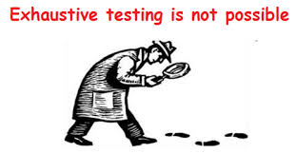
Testing shows the presence of defects
No test team , test technique or test strategy can achieve 100% defect detection effectiveness
As testing continues we reduce the likelihood of defects that remain uncovered
2. Exhaustive Testing is impossible:
Confronted with a big infinite cloud of possible tests – select a subset
Strategy 1
Risk based testing – Cross functional team of project and product stakeholders – perform a special type of risk analysis
Stakeholders identify risks to the quality of the system and assess the level of risk associated with each risk item
Focus the test effort based on the level of risk – using the level of risk to determine appropriate number of test cases
1. T

Slide 46

Strategy 2
Requirements based testing
Focus the test effort based on the priority of requirements to determine appropriate number of test cases for each requirement and to sequence the test cases.
3. Early Testing
Cost of finding and removing a defect increases the longer that defect is in the system
Defects removed early cost less to remove
Most of the cost in Software Engineering is associated with human effort – reduced cost of defects reduces duration of the project

Slide 47


4. Defect Clustering
The Pareto principle (also known as the 80–20 rule states that, for many events, roughly 80% of the effects come from 20% of the causes.
20% of the modules account for 80% of defects
This provides a guide to testers to focus test effort on expected and ultimately observed likeliehood of finding a bug in a certain area
5. Pesticide Paradox
Boris Beizer – observed that pesticide repeatedly sprayed on a field will kill fewer and fewer bugs each time.
A given set of tests will eventually stop finding new defects when re-run under a system under development or maintenance.
Plan to regularly review test results during project and revise tests based on findings.
Sometimes write new and different tests to exercise different parts of the software or system.

Slide 48

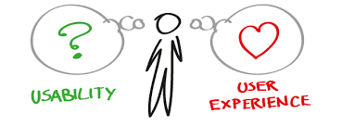
6. Testing is context dependent
Apply safety critical approaches to an e-commerce site- you may put company out of business
Apply e-commerce approaches to safety critical systems – you may put lives in danger
7. Absence of errors fallacy
Many systems built which failed user acceptances testing or in the market place
Why does Windows dominate market place? Apple Iphone?

Slide 49

Psychology of Testing
Independent Testing – who is a tester?
A tester is coming to the process from a critical perspective, unlike a designer or developer who are working positively or optimistically towards the project, the tester must always focus on judging and appraising
.

Slide 50

Psychology of Testing
Independent Testing – who is a tester?
Suppose you were going to cook a meal to enter in a competition for chefs. You select the menu, collect the ingredients, cook the food, set the table, and serve the meal. If you want to win, you do each task as well as you can.
Suppose instead you are one of the judges evaluating the competition meals. You examine everything critically, including the menu, the ingredients, the methods used, keeping to time and budget allowances, choice of ingredients, the elegance of the table setting and the serving, and the look and taste of the meal. To differentiate between the competition chefs, you'll praise every good aspect of their performances but you'll also note every fault and error each chef made.
So it is with software testing: building the software requires a different mindset from testing the software.

Slide 51
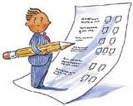

Psychology of Testing
Independent Testing – who is a tester?
This is not to say that a programmer cannot be a tester, or a tester cannot be a programmer, and in fact in many organisations people assume both roles at different time.
The programmer is usually the first line of testing since they will be testing elements of the programs as they are writing the code, and will be finding and eliminating errors before anyone else sees the code.

Slide 52

Psychology of Testing
Independent Testing – who is a tester?
The big problem is that it’s hard to spot issues with your own work, so someone who is independent of the development process is better to review and judge.

Slide 53

Psychology of Testing
Independent Testing – who is a tester?
Several levels of independence can be identified, listed here from the lowest level of independence to the highest:
tests by the person who wrote the item under test
tests by another person within the same team, such as another programmer
tests by a person from a different organizational group, such as an independent test team
tests designed by a person from a different organization or company, such as outsourced testing or certification by an external body

Slide 54
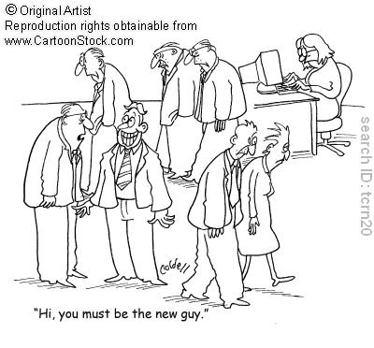
Psychology of Testing
Why do we sometimes not get on with the rest of the team?
Some people on a team want to get the project done and delivered as quickly as possible, whereas others what to ensure that a bug-free system is delivered.

Slide 55

Spectrum of independence of testing
Separation of responsibilities to encourage objective testing
Tests designed and executed by software developer- low level of independence
Tests designed by someone other than the author but someone from within the development team- Fact that they are from same group limits the independence of thought
When tests are designed by people from a different organizational group- independent test team or tester who specialize in usability or performance testuing
When tests are designed by people from a different organization or comapany – outsource testing service provider or system certification body(FDA for pharmaceutical systems ) – highest level of independence

Slide 56
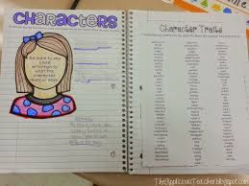
Following Traits required for tester role:

Slide 57

Psychology of Testing
Why do we sometimes not get on with the rest of the team?
If people are unclear as to the amount of testing that has to be done to complete the test strategy, or if development takes longer than anticipated, there may be pressure to truncate the test process.

Slide 58
Psychology of Testing
Why do we sometimes not get on with the rest of the team?
When a tester is checking code, if they detect errors they perceive this as a good thing, we have found defects or failures in the system.

Slide 59
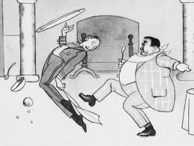
Psychology of Testing
Why do we sometimes not get on with the rest of the team?
However many developers take great pride is their work, and the software they write becomes personal to them, from their point-of-view any flaws that are uncovered about the system could be taken as a personal attack on them.

Slide 60
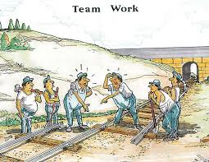
Psychology of Testing
Why do we sometimes not get on with the rest of the team?
So.....

Slide 61

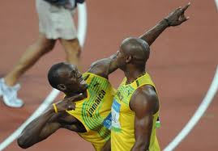
Psychology of Testing
Why do we sometimes not get on with the rest of the team?
Communicate findings on the product in a neutral, fact-focused way without criticizing the person who created it. For example, write objective and factual incident reports and review findings.
Don't gloat - you are not perfect either!
Don't blame - any mistakes are probably by the group rather than an individual.
Be constructively critical and discuss the defect and how you are going to log it.

Slide 62

Psychology of Testing
Why do we sometimes not get on with the rest of the team?
Explain that by knowing about this now we can work round it or fix it so the delivered system is better for the customer.
Say what you liked and what worked, as well as what didn't work.
Show what the risk is honestly - not everything is high priority.
Don't just see the pessimistic side - give praise as well as criticism.
Show what risks have been uncovered and the benefits of the review or test.

Slide 63
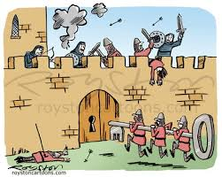
Psychology of Testing
Why do we sometimes not get on with the rest of the team?
Start with collaboration rather than battles. Remind everyone of the common goal of better quality systems.
Be polite and helpful, collaborate with your colleagues.
Try to understand how the other person feels and why they react as they do.
Confirm that the other person has understood what you have said and vice versa.
Explain how the test or review helps the author - what's in it for them.
Offer your work to be reviewed, too

